Slide 1

ECE 2700
Digital Circuits
Decoder, Encoder, and Multiplexer
Copyright © 2010 Frank Vahid
Instructors of courses requiring Vahid's Digital Design textbook (published by John Wiley and Sons) have permission to modify and use these slides for customary course-related activities, subject to keeping this copyright notice in place and unmodified. These slides may be posted as unanimated pdf versions on publicly-accessible course websites.. PowerPoint source (or pdf with animations) may not be posted to publicly-accessible websites, but may be posted for students on internal protected sites or distributed directly to students by other electronic means. Instructors may make printouts of the slides available to students for a reasonable photocopying charge, without incurring royalties. Any other use requires explicit permission. Instructors may obtain PowerPoint source or obtain special use permissions from Wiley – see http://www.ddvahid.com for information.

Slide 2
Today’s Objective
To become familiar with the following basic circuit components
  Decoders
  Encoders
  Muxes

Slide 3

Quick Verilog Tips
If you need to initialize a value
  Example: int i = 0; //C
In Verilog
  output i;
  …
  assign i = 0;
You can also use Boolean operators
  output f;
  …
  assign f = (a & b) | ~c;
…
input a, b, c;
output f;
wire N1, N2;
…
not not1(N1, c);
and and1(N2, a, b);
or or1(f, N2, N1);
…
a
f
b
c

Slide 4
Decoders
Inputs: n bits, outputs: 2^{n} elements
Converts input binary number to one high output
2-input decoder: four possible input binary numbers
  So has four outputs, one for each possible input binary number
d0
1
d0
0
d0
0
d0
0
0
i1
d1
0
0
i1
d1
1
1
i1
d1
0
1
i1
d1
0
0
i0
d2
0
1
i0
d2
0
0
i0
d2
1
1
i1
d2
0
d3
0
d3
0
d3
0
d3
1

Slide 5

Decoder Circuit Implementation
module 2x4Dec(d3, d2, d1, d0, i1, i0);
  input i1, i0;
  output d3, d2, d1, d0;
  and a1(d0, ~i1, ~i0);
  and a2(d1, ~i1, i0);
  and a3(d2, i1, ~i0);
  and a4(d3, i1, i0);
endmodule
i1’i0’
d0
i1’i0
d1
i1i0’
d2
i1i0
d3
Alternatively…
…
assign d0 = ~i1 & ~i0;
assign d1 = ~i1 & i0;
assign d2 = i1 & ~i0;
assign d3 = i1 & i0;
i1
i0

Slide 6
Question (AP)
What would the input values of a 3x8 decoder be if the output values are
  d0 = 0 d4 = 0
  d1 = 0 d5 = 0
  d2 = 0 d6 = 0
  d3 = 1 d7 = 0
  i2 = 0, i1 = 1, i0 = 0
  i2 = 0, i1 = 1, i0 = 1
  i2 = 1, i1 = 0, i0 = 0
  i2 = 1, i1 = 0, i0 = 1
  ☹

Slide 7
Decoders With Enable
Outputs all 0 if e = 0
Regular behavior if e = 1
module 2x4DecEn(d3, d2, d1, d0, i1, i0, e);
  input i1, i0, e;
  output d3, d2, d1, d0;
  and a1(d0, ~i1, ~i0, e);
  and a2(d1, ~i1, i0, e);
  and a3(d2, i1, ~i0, e);
  and a4(d3, i1, i0, e);
endmodule
d0
0
1
i0
d1
0
1
i1
d2
0
e
d3
1
1
d0
0
1
i0
d1
0
1
i1
d2
0
e
d3
0
0

Slide 8
Design Question
Build a 3x8 decoder using two 2x4 decoders with enable
Inputs |  |  | Outputs
x | y | z | d0 | d1 | d2 | d3 | d4 | d5 | d6 | d7
0 | 0 | 0 | 1 | 0 | 0 | 0 | 0 | 0 | 0 | 0
0 | 0 | 1 | 0 | 1 | 0 | 0 | 0 | 0 | 0 | 0
0 | 1 | 0 | 0 | 0 | 1 | 0 | 0 | 0 | 0 | 0
0 | 1 | 1 | 0 | 0 | 0 | 1 | 0 | 0 | 0 | 0
1 | 0 | 0 | 0 | 0 | 0 | 0 | 1 | 0 | 0 | 0
1 | 0 | 1 | 0 | 0 | 0 | 0 | 0 | 1 | 0 | 0
1 | 1 | 0 | 0 | 0 | 0 | 0 | 0 | 0 | 1 | 0
1 | 1 | 1 | 0 | 0 | 0 | 0 | 0 | 0 | 0 | 1

Slide 9
3-to-8 Decoder
Using
  module 2x4DecEn(d3, d2, d1, d0, i1, i0, e);
module 3x8Dec(D7, D6, D5, D4, D3, D2, D1, D0, x, y, z);
  input x, y, z;
  output D7, D6, D5, D4, D3, D2, D1, D0;
  2x4DecEn dec1(D3, D2, D1, D0, y, z, ~x);
  2x4DecEn dec2(D7, D6, D5, D4, y, z, x);
endmodule

Slide 10

Decoder Use Example
Countdown system
2
1
0
2
1
0
0
1
0
0
0
1
0
1
0
0
i0
d0
0
1
0
0
0
0
i1
d1
1
0
0
1
0
0
0
i2
d2
0
0
0
2
Processor
i3
d3
3
0
0
0
i4
0
0
0
i5
d58
0
0
0
e
d59
0
0
0
d60
d61
58
6x64
d62
59
dcd
d63

Slide 11
Active-Low Inputs
Control inputs
  Influence component
  behavior
  E.g., enable bit
Active high
  1 causes input to carry out its
  purpose
Active low
  0 causes input to carry out its purpose
    Example: 2x4 decoder with active low enable
    1 disables decoder, 0 enables
    Drawn using inversion bubble
d0
0
d0
0
1
i0
d1
0
1
i0
d1
0
1
i1
d2
0
1
i1
d2
0
e
d3
0
e
d3
1
1
0

Slide 12
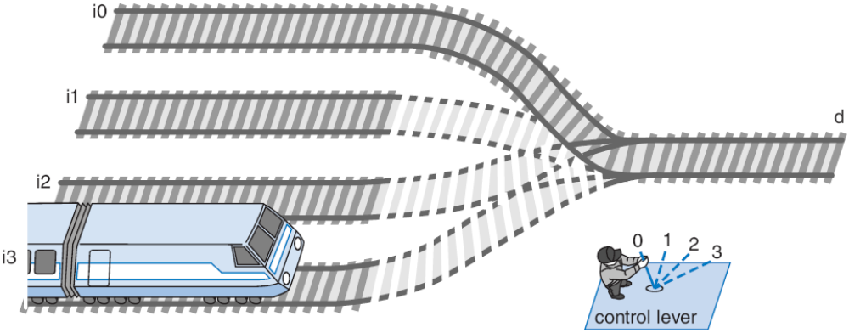
Multiplexer (Mux)
Routes one of its N data inputs to its one output, based on binary value of select inputs
  4-input mux: needs 2 select inputs to indicate which input to route through
  8-input mux: 3 select inputs
N inputs: log₂(N) selects

Slide 13
Mux Internal Design
Mux: data selector
i0
i0 (1*i0=i0)
1
d
i0 (0+i0=i0)
i1
0
2
×
1
2
×
1
2
×
1
0
i0
i0
i0
i1
d
i1
d
i1
d
s0
s0
s0
0
s0
0
1
2x1 mux
i0
4x
1
i0
i1
Can you build a 2x1 mux in Verilog?
i1
d
i2
d
i2
i3
s1
s0
i3
4x1 mux
s1
s0

Slide 14
N-Bit Mux
Ex: Two 4-bit inputs, A (a3 a2 a1 a0), and B (b3 b2 b1 b0)
  4-bit 2x1 mux (just four 2x1 muxes sharing a select line) can select between A or B
a3
i0
2x
1
Simplifying
notation:
b3
i1
d
s0
4-bit
4
a2
i0
2x
1
4
2x1
C
i1
d
A
I
0
4
b2
s0
4
D
C
is short
B
I
1
f
or
a1
i0
2x
1
s0
b1
i1
d
c3
s0
2x
1
s0
c2
a0
i0
d
b0
i1
c1
s0
s0
c0

Slide 15
N-Bit Mux in Verilog
`timescale 1 ns/1 ns
module mux2_4b(A3, A2, A1, A0,
B3, B2, B1, B0,
S0,
C3, C2, C1, C0);
input A3, A2, A1, A0;
input B3, B2, B1, B0;
input S0;
output C3, C2, C1, C0;
mux2 mux2_3 (B3, A3, S0, C3);
mux2 mux2_2 (B2, A2, S0, C2);
mux2 mux2_1 (B1, A1, S0, C1);
mux2 mux2_0 (B0, A0, S0, C0);
endmodule
Create four mux2 instances
A3
mux2_4b
A2
C3
Mux2_4b
A1
C2
A0
C1
A3
I0
Mux2
B3
C0
B3
I1
D
C3
B2
S0
B1
Mux2
B0
A2
I0
D
C2
B2
I1
S0
S0
Can then use mux2_4b in another module’s circuit, and so on ...
A1
I0
Mux2
B1
I1
D
C1
S0
A0
I0
Mux2
B0
I1
D
C0
S0
s0

Slide 16
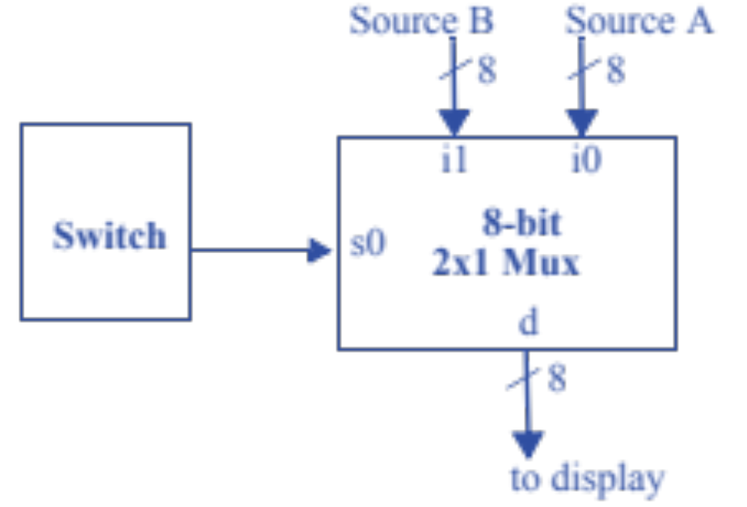
Example Mux Use
A video system can accept video from two sources, but can only display one source at a given time
  Assume each source is 8-bit wide

Slide 17
Other Components
Encoder
Demultiplexor (Demux)

Slide 18
8x3 Encoder
Inputs |  |  |  |  |  |  |  | Outputs
d0 | d1 | d2 | d3 | d4 | d5 | d6 | d7 | x | y | z
1 | 0 | 0 | 0 | 0 | 0 | 0 | 0 | 0 | 0 | 0
0 | 1 | 0 | 0 | 0 | 0 | 0 | 0 | 0 | 0 | 1
0 | 0 | 1 | 0 | 0 | 0 | 0 | 0 | 0 | 1 | 0
0 | 0 | 0 | 1 | 0 | 0 | 0 | 0 | 0 | 1 | 1
0 | 0 | 0 | 0 | 1 | 0 | 0 | 0 | 1 | 0 | 0
0 | 0 | 0 | 0 | 0 | 1 | 0 | 0 | 1 | 0 | 1
0 | 0 | 0 | 0 | 0 | 0 | 1 | 0 | 1 | 1 | 0
0 | 0 | 0 | 0 | 0 | 0 | 0 | 1 | 1 | 1 | 1
x = d0’d1’d2’d3’d4d5’d6’d7’ + d0’d1’d2’d3’d4’d5d6’d7’ + d0’d1’d2’d3’d4’d5’d6d7’ + d0’d1’d2’d3’d4’d5’d6’d7
y = d0’d1’d2d3’d4’d5’d6’d7’ + d0’d1’d2’d3d4’d5’d6’d7’ + d0’d1’d2’d3’d4’d5’d6d7’ + d0’d1’d2’d3’d4’d5’d6’d7
z = …

Slide 19
8x3 Priority Encoder
Inputs |  |  |  |  |  |  |  | Outputs
d0 | d1 | d2 | d3 | d4 | d5 | d6 | d7 | x | y | z
0 | 0 | 0 | 0 | 0 | 0 | 0 | 0 | X | X | X
1 | 0 | 0 | 0 | 0 | 0 | 0 | 0 | 0 | 0 | 0
X | 1 | 0 | 0 | 0 | 0 | 0 | 0 | 0 | 0 | 1
X | X | 1 | 0 | 0 | 0 | 0 | 0 | 0 | 1 | 0
X | X | X | 1 | 0 | 0 | 0 | 0 | 0 | 1 | 1
X | X | X | X | 1 | 0 | 0 | 0 | 1 | 0 | 0
X | X | X | X | X | 1 | 0 | 0 | 1 | 0 | 1
X | X | X | X | X | X | 1 | 0 | 1 | 1 | 0
X | X | X | X | X | X | X | 1 | 1 | 1 | 1
x = d4d5’d6’d7’ + d5d6’d7’ + d6d7’ + d7
y = d2d3’d4’d5’d6’d7’ + d3d4’d5’d6’d7’ + d6d7’ + d7
z = d1d2d3’d4’d5’d6’d7’ + d3d4’d5’d6’d7’ + d5d6d7’ + d7

Slide 20
Today’s Objective
To become familiar with the following basic circuit components
  Decoders
  Encoders
  Muxes

Slide 21
Question
We want to design circuit that computes the majority function (F = 1 if two or more input bits are 1). What logic gate do we need?
A | B | C | F
0 | 0 | 0 | 0
0 | 0 | 1 | 0
0 | 1 | 0 | 0
0 | 1 | 1 | 1
1 | 0 | 0 | 0
1 | 0 | 1 | 1
1 | 1 | 0 | 1
1 | 1 | 1 | 1
A
3-to-8 Decoder
D3
B
D5
C
D6
D7
?
F

